Slide 1

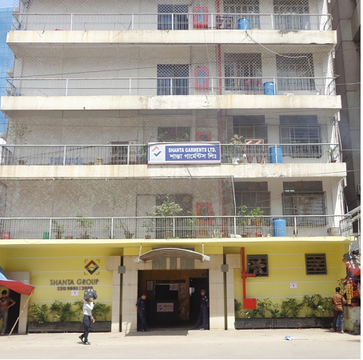
Shanta Garments Ltd.
Supplier: Shanta Garments Ltd. & Shanta Garments Ltd. Unit-1
sister concern of Shanta Group.
Established in 1989.
Number of Employees: 3000 persons.
Facility: 160,000 Sq Ft, plant.
Production capacity: 15000 pcs of woven bottoms per day.
Total Production Capacity: For Woven 3.75 million units/month.
Accreditations: ISO 9001:2008 & CTPAT.
Fully fledged Sample room.
EDI, Scan & Pack Compatibility.
State of the art production facilities.
Turnover: US$ 12.10 m in FY 2014(Shanta Garments Ltd., Gulshan
Unit).
Products: Woven bottoms and tops.
27 years of expertise in apparel manufacturing and export.
Highly Skilled & Trained Work Force.
Educated Compliance Standards.
Efficient Logistic & Finance team.
Major Customers: Tommy Hilfiger, McGregor, Raymond, s.Oliver, ASCEND, ColorPlus PARX.
Strengths: Competitive price, short lead time with goods quality on time delivery.
Also we have one of the biggest WASHING PLANT.
International Sourcing - clothing
Supplier Slide
We deliver the right product, at the right cost on time

Slide 2
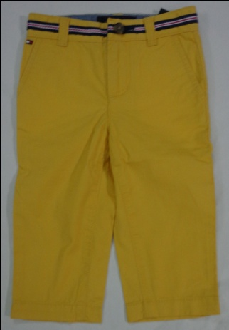
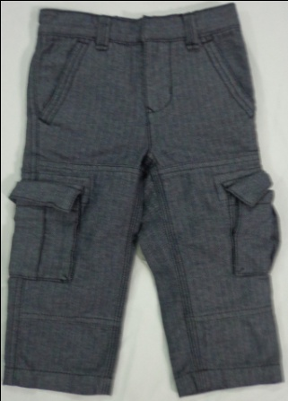
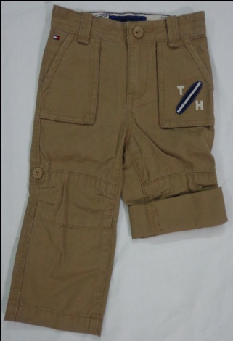
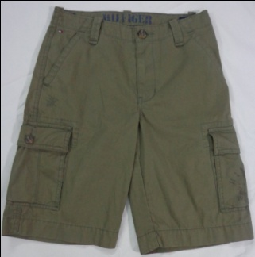
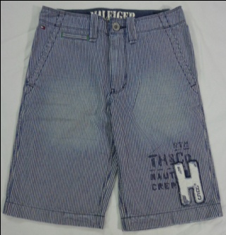
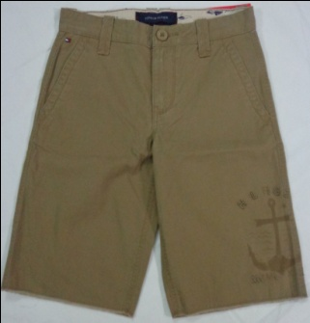
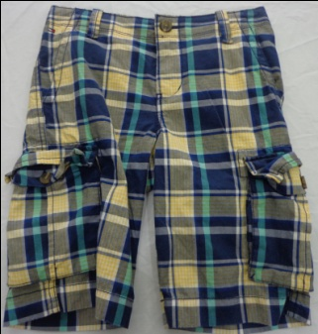
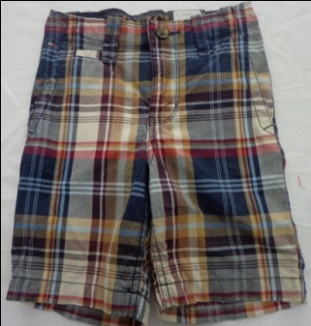
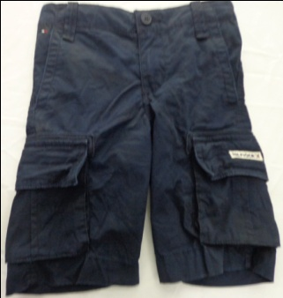
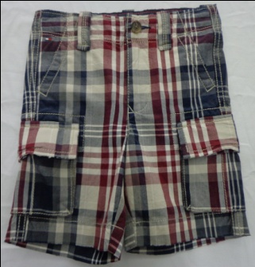
Shanta product line:
Boy’s Pant & Short
International Sourcing - clothing
Supplier Slide
We deliver the right product, at the right cost on time

Slide 3
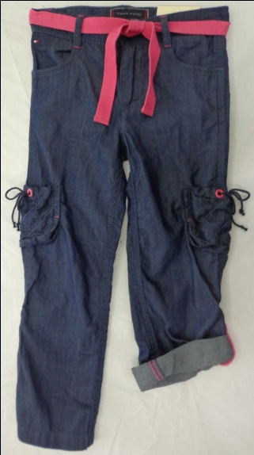
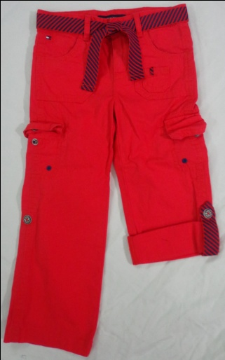
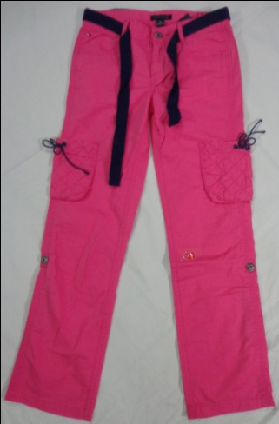
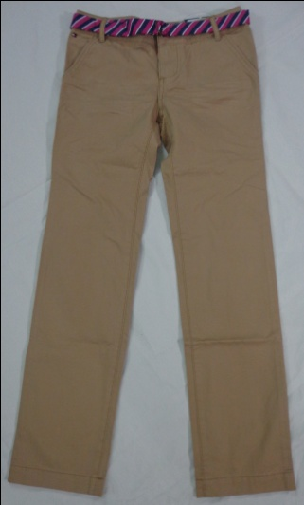
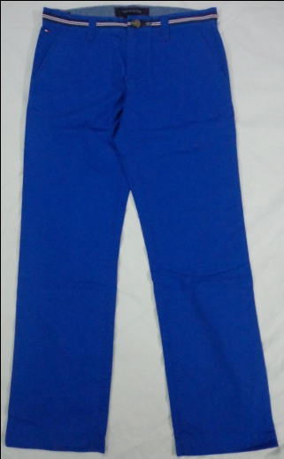
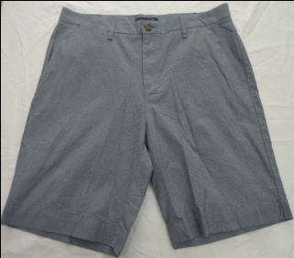
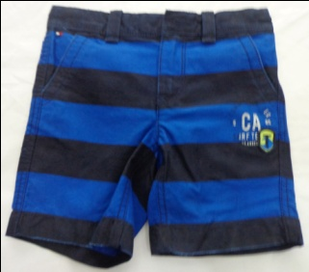
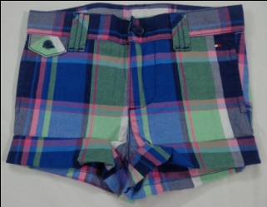
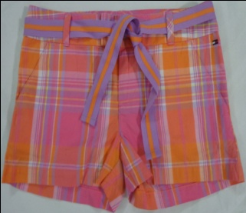
Girl’s Pant & Short
International Sourcing - clothing
Supplier Slide
We deliver the right product, at the right cost on time

Slide 4
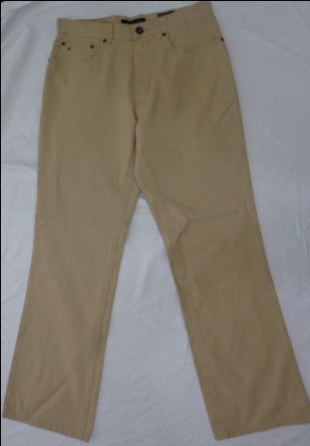
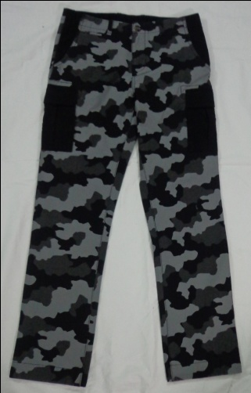
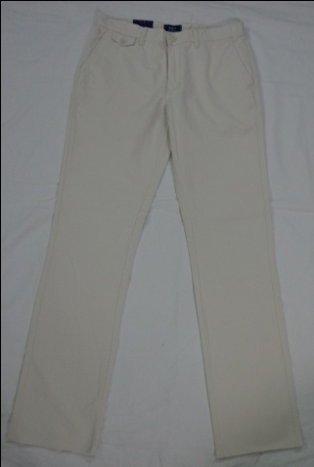
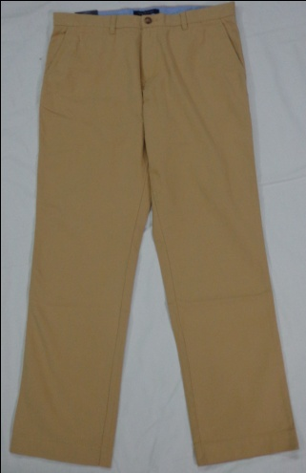
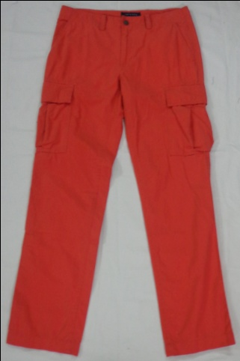
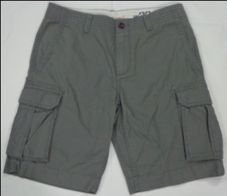
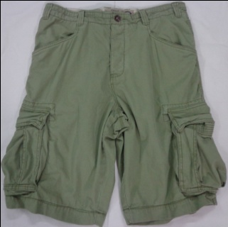
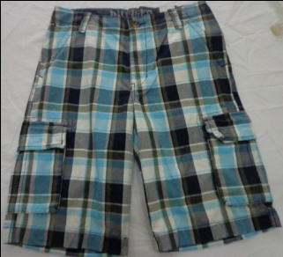
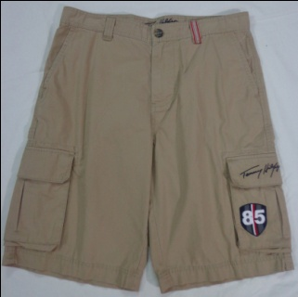
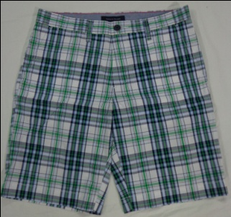
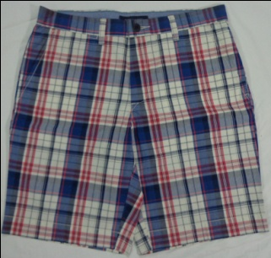
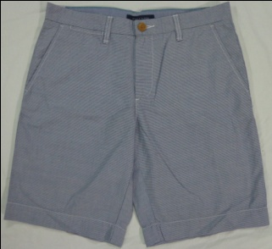
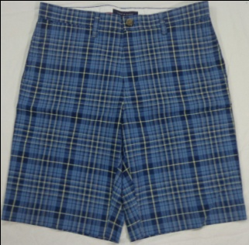
Men’s Pant & Short
International Sourcing - clothing
Supplier Slide
We deliver the right product, at the right cost on time

Slide 5
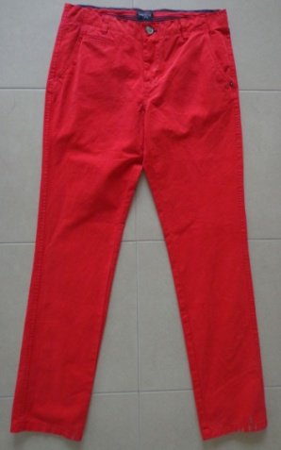
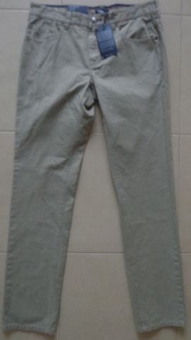
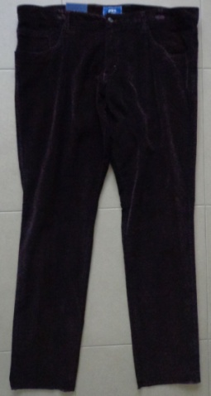
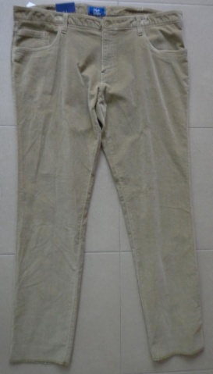
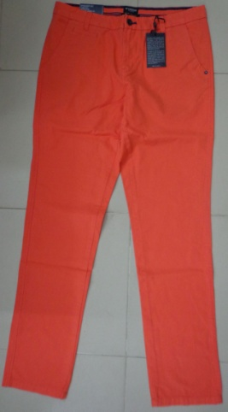
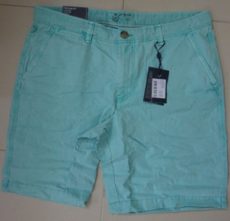
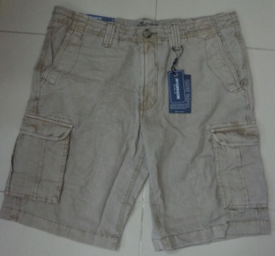
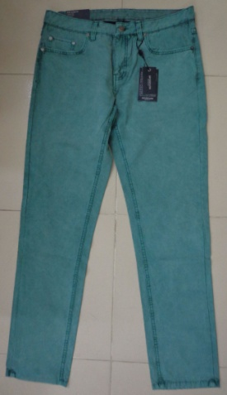
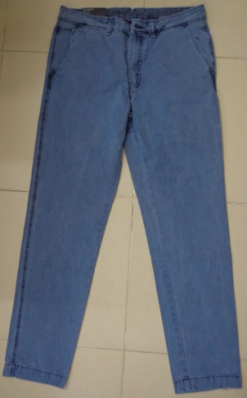
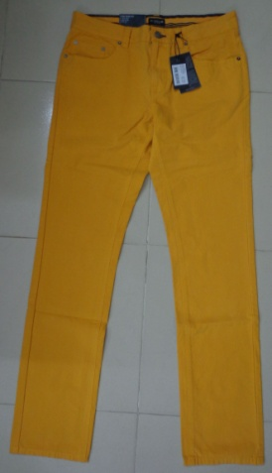
Men’s Pant & Short
International Sourcing - clothing
Supplier Slide
We deliver the right product, at the right cost on time

Slide 6
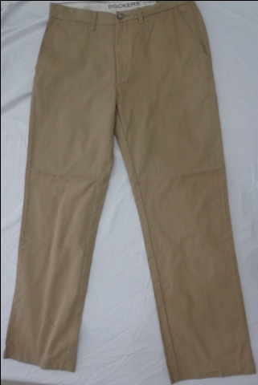
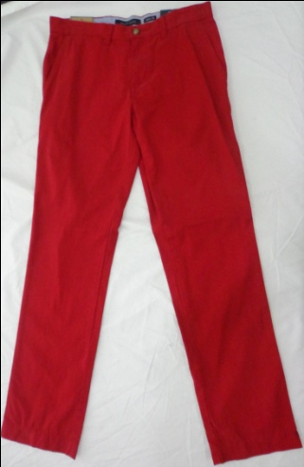
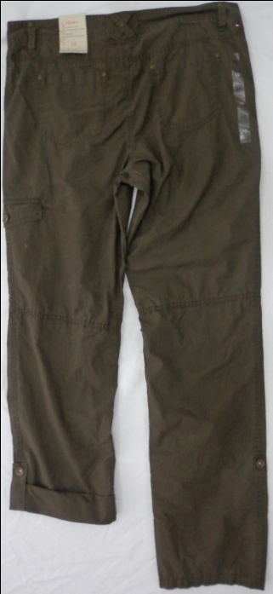
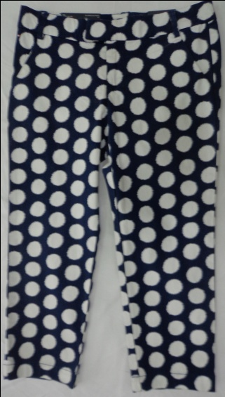
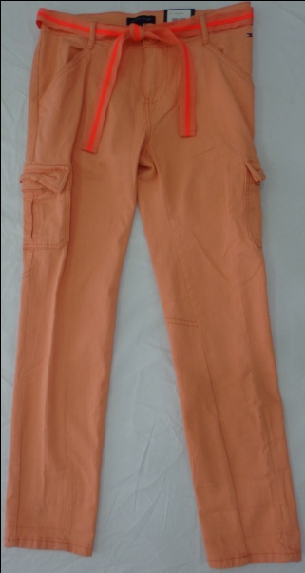
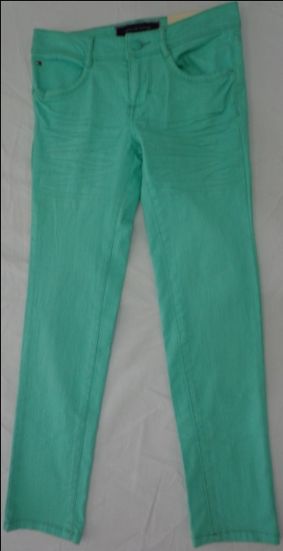
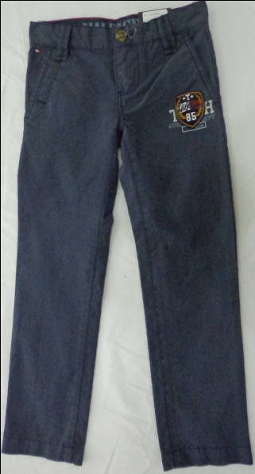





Women’s Pant
International Sourcing - clothing
Supplier Slide
We deliver the right product, at the right cost on time

Slide 7










Women’s Short
Women’s Skirt
International Sourcing - clothing
Supplier Slide
We deliver the right product, at the right cost on time

Slide 8






Customers
International Sourcing - clothing
Supplier Slide
We deliver the right product, at the right cost on time

Slide 9
Key Contacts:
Mr. Khondoker Jamil Uddin (Chairman & Managing Director)
  jamil@sgl.shantagroup.com
Mr. Reshad Hossain Khan (Director)
  reshad@sgl.shantagroup.com
Mr. Syed Ashraful Islam FCMA(CEO)
  ashraf@sgl.shantagroup.com
Mr. Jimmy Paryani – (Director Sourcing)
  jimmy@shingon-bd.com
Mr. Shamsul Alam Talukder
  shamsu@shingon-bd.com
  Head office:
  31, Gulshan Avenue, Circle-1, Gulshan, Dhaka-1212, Bangladesh.
  Factory:
  31, Gulshan Avenue, Circle-1, Gulshan, Dhaka-1212, Bangladesh.
  Marketing & Sourcing:
  Apt. # 6E & 6W, CWS(C)-8, South Avenue, Gulshan-1, Dhaka–1212, Bangladesh.
  www.shantagroup.com
International Sourcing - clothing
Supplier Slide
We deliver the right product, at the right cost on time

